Slide 1

Deep Learning-based MRI Classification for Alzheimer’s Detection
22BIO211 – Intelligence of Biological Systems - II
TEAM – 3
CH.SC.U4AIE23011 – Dhanushrinivas K
CH.SC.U4AIE23020 – Jakka Aniketh Reddy
CH.SC.U4AIE23037 – Nammi Bhargav
CH.SC.U4AIE23039 – Nethi Sathwik
CH.SC.U4AIE23055 – Sunilraj D
CH.SC.U4AIE23056 – Talasila Balaji

Slide 2
SL No. | Title | Author/ Journal year | Methodology | Merits | Demerits | Research Gap
1 | MRI scan based alzheimer's disease prediction via CNN and Transfer learning | Marwa EL-Geneedya, Hossam El-Din Moustafa a, Fahmi Khalifa a ,Hatem Khater b , Eman AbdElhalim | Their past review was based on OASIS-1,2 and 3 models and they wanted to improve the accuracy of the model. CNN – Feature extraction TL – Hyper parameter tuning GAN – generate additional data | Uses CNN , Transfer Learning and Generative Adversarial Networks to improve the accuracy by almost 40.1% and tested among 3 datasets to allow generalization | No proper cross validation. Ignored imbalance data No data augmentation Bias by using GAN data | Limited use of dataset(worked on only partial dataset) No data augmentation Only single model is trained
2 | Deep-learining approach for early detection of alzheimer's disease | Kwok Tai Chui, Brij B. Gupta, Wadee Alhalabi, Fatma Salih Alzahrani 2022 | CNN – Custom 2D and 3D Pretrained VGG19 – Transfer learning Approach used(improves performance) 2D-M21c – 93.6% 3D-M21c – 95.17% Finetune – 97.0% | Uses CNN with Transfer Learning (TL) and GAN for AD detection. Fine-tunes hyperparameters using OASIS datasets. Addresses class imbalance with GAN-generated samples. Achieves up to 97.9% accuracy. | Oversampling ADNI – only dataset used that has very limited features Uses pretrained models No subject level splitting | No hybrid approach combining traditional ML (e.g., XGBoost, SVM). No explicit comparison with transformer models. Focuses on MRI data, lacks multimodal fusion.

Slide 3
SL No. | Title | Author/ Journal year | Methodology | Merits | Demerits | Research Gap
3 | MRI based deep learning approach for accurate detection of Alzheimer’s disease | Marwa EL-Geneedy a, , Hossam El-Din Moustafa a , Fahmi Khalifa a , Hatem Khater b , Eman AbdElhalim 2022 | Used T1 – Weighted MRI scans Used oasis 3 dataset – 6400 images. Data augmentation – horizontal flipping 5 2D CNN layers and max pooling of dropout layers. Uses soft max activation | - Uses shallow CNN for MRI image classification. - Compares multiple deep learning models (VGG16, DenseNet121, ResNet50, etc.). - Stratifies MCI stages into subcategories (VMD, MD, MoD) | Horizontal flipping only Did not mention subject-wise splitting | Relies on CNN only, no hybrid approach. No inclusion of XGBoost or SVM. Limited use of feature engineering techniques like ViT. .Focuses only on MRI, no multimodal data integration
4 | Deeplearining based CNN model with VG16 feature extraction | John Oyekan 1,and Huosheng Hu 2012 | Data augmentation – Horizontal flipping Used VG16 to extract deep features. Feed forward neural network Adam optimizer Accuracy – 90% | Uses VGG16 as a feature extractor for MRI-based AD detection. Achieves 90.4% accuracy on Dataset 1 and 71.1% on Dataset 2. Compares multiple pre-trained models. Analyzes feature importance. | Data augmentation Subject wise splitting Uses pretrained model | Relies on a single feature extractor (VGG16). No hybrid approach with XGBoost or SVM. No integration of ViT for feature enhancement. Does not explore multimodal fusion beyond MRI

Slide 4
SL No. | Title | Author/ Journal year | Methodology | Merits | Demerits | Research Gap
5 | ADD-net:An effective deep learning model for early detection of alzheimer's detection in MRI scan | MIAN MUHAMMAD SADIQ FAREED1 , SHAHID ZIKRIA2 , GULNAZ AHMED3 , MUI-ZZUD-DIN4 , SAQIB MAHMOOD2 , MUHAMMAD ASLAM5 , SYEDA FIZZAH JILLANI6 , AHMAD MOSTAFA7 AND MUHAMMAD ASAD7 1Department of Software Engineering, University 2022 | SMOTETOMEK(synthetic minority oversampling) Densenet .VGG19 used for comparison and testing | - Custom CNN model (ADD-Net) optimized for small datasets. Uses SMOTETOMEK to address class imbalance. Grad-CAM for visualization of affected brain areas. .Outperforms DenseNet169, VGG19, InceptionResNetV2 in accuracy and AUC | Data balancing is poor No subject wise splitting Used pre-trained models | Lacks hybrid model approach (only CNN-based). Limited model diversity (does not use XGBoost or SVM). Dataset modality is MRI-focused, missing multi-modal integration. Feature extraction could be enhanced with Vision Transformer
6 | Deep Learning-Based Classification of FDG-PET Data for Alzheimer's Disease Diagnosis | Hyeon Jeong, Seong Ho Park, and Seong Ho Jeon 2019; | Used FDG-PET imaging data from ADNI (210 subjects). Applied spatial and intensity normalization. Used PCA for dimensionality reduction. Classified using SVM | FDG-PET detects early metabolic changes in AD. PCA reduces overfitting and improves efficiency. SVM is a robust classifier for high-dimensional data. | Uses only FDG-PET, lacks multimodal integration. Small sample size (210 subjects). Cross-validation strategy not specified. | Lacks multimodal integration (MRI, biomarkers). Could use deep learning models (CNN, ViT). No longitudinal analysis for disease progression. Needs larger, diverse datasets for generalization.

Slide 5
TEAM-3
PROBLEM STATEMENT
22BIO211
The Challenge
Alzheimer’s Disease (AD) is a progressive neurodegenerative disorder affecting millions worldwide.
Early detection is crucial for timely intervention and treatment.
Limitations of Traditional Diagnosis
Manual MRI interpretation is time-consuming and subjective.
High variability in diagnosis due to human factors.
Limited accuracy in differentiating early-stage cognitive impairment.

Slide 6
TEAM-3
Objectives
22BIO211
Accurately classify cognitive impairment into four stages:
No Impairment
Very Mild Impairment
Mild Impairment
Moderate Impairment
Improve classification accuracy and generalization for real-world
applications.
Develop an AI-driven MRI classification system using CNN and a hybrid
stacking ensemble (SVM, XGBoost, Random Forest).

Slide 7
INTRODUCTION
TEAM-3
22BIO211
Alzheimer’s Disease (AD) is a progressive neurodegenerative disorder that affects memory and cognitive functions, impacting millions worldwide. Early detection is crucial for timely intervention, but traditional MRI-based diagnosis relies on manual interpretation, which is time-consuming and prone to variability. Magnetic Resonance Imaging (MRI) is widely used to detect structural brain abnormalities, but analyzing these scans manually can lead to inconsistencies. To address these challenges, this study leverages deep learning, specifically Convolutional Neural Networks (CNNs) and a hybrid stacking ensemble (SVM, XGBoost, and Random Forest), to automate MRI-based classification of cognitive impairment. The proposed AI model categorizes MRI scans into four stages: No Impairment, Very Mild Impairment, Mild Impairment, and Moderate Impairment. By integrating machine learning with medical imaging, this approach aims to enhance diagnostic accuracy, reduce human error, and provide a scalable solution for early Alzheimer’s detection.

Slide 8
MODELS USED
TEAM-3
22BIO211
CNN Model (Convolutional Neural Network)
Standard deep learning model for image classification.
Consists of multiple convolutional layers, pooling layers, and fully connected layers.
Uses dropout regularization to reduce overfitting.
Trained with categorical cross-entropy loss and evaluated using accuracy, AUC-ROC, and AUC-PR.

Slide 9
MODELS USED
TEAM-3
22BIO211
Hybrid Model (CNN + Stacking Ensemble Classifier)
Enhances CNN-based feature extraction by integrating traditional machine learning classifiers.
Features extracted using CNN are processed with:
Support Vector Machine (SVM)
XGBoost (Extreme Gradient Boosting)
Random Forest
A Logistic Regression meta-classifier combines predictions from these models.
Uses Principal Component Analysis (PCA) for dimensionality reduction.

Slide 10
METHODOLOGY
TEAM-3
22BIO211
Dataset & Preprocessing
MRI scans categorized into four cognitive impairment levels:
No Impairment
Very Mild Impairment
Mild Impairment
Moderate Impairment
Images are converted to grayscale, normalized (0-1 pixel scaling), and resized to 128×128 pixels to ensure uniform input.

Slide 11
METHODOLOGY
TEAM-3
22BIO211
CNN Model for Feature Extraction
A Convolutional Neural Network (CNN) extracts features from MRI scans.
Uses convolutional layers for feature detection, pooling layers for dimensionality reduction, and fully connected layers for classification.
Softmax activation predicts cognitive impairment categories.
Hybrid Model - CNN + Stacking Classifier
The CNN-extracted features are used as input for a hybrid stacking ensemble.
Includes Support Vector Machine (SVM), XGBoost, and Random Forest classifiers.
A Logistic Regression meta-classifier combines their predictions for the final output.

Slide 12
TEAM-3
22BIO211
METHODOLOGY
Training & Optimization
The model is trained using categorical cross-entropy loss with the Adam optimizer.
Dropout regularization and data augmentation are applied to prevent overfitting.
Evaluation Metrics
Accuracy, AUC-ROC, AUC-PR, Precision, Recall, F1-score are used for performance assessment.
Comparison between CNN and Hybrid Model to analyze robustness and generalization.

Slide 13
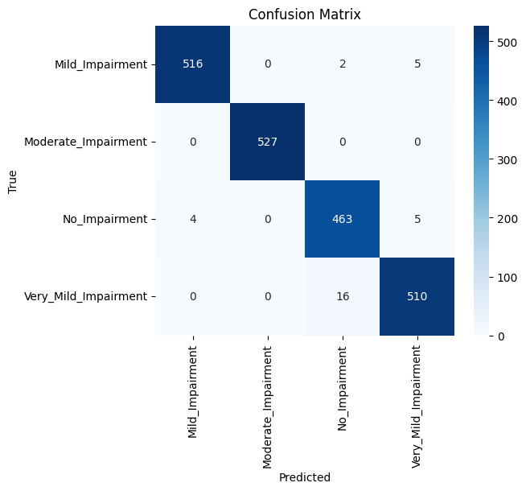
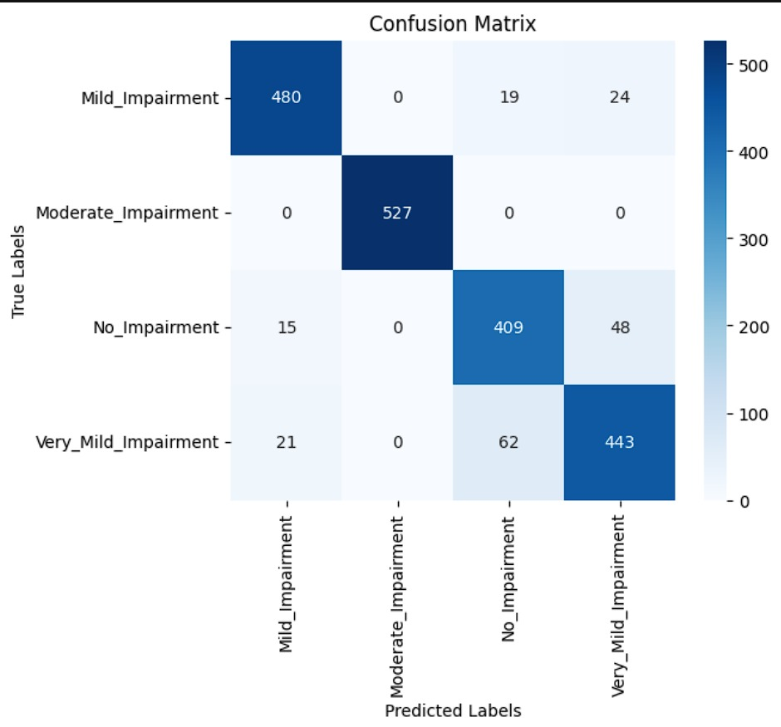
TEAM-3
22BIO211
RESULTS
CNN Model
Hybrid Model

Slide 14
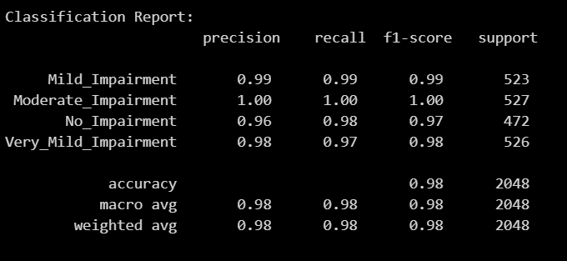
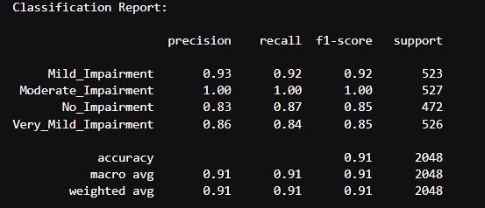
TEAM-3
22BIO211
RESULTS
CNN Model
Hybrid Model

Slide 15
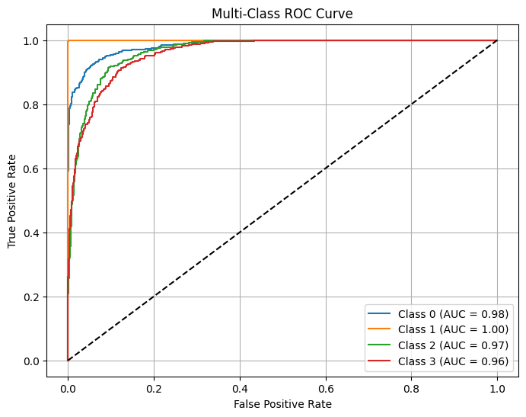
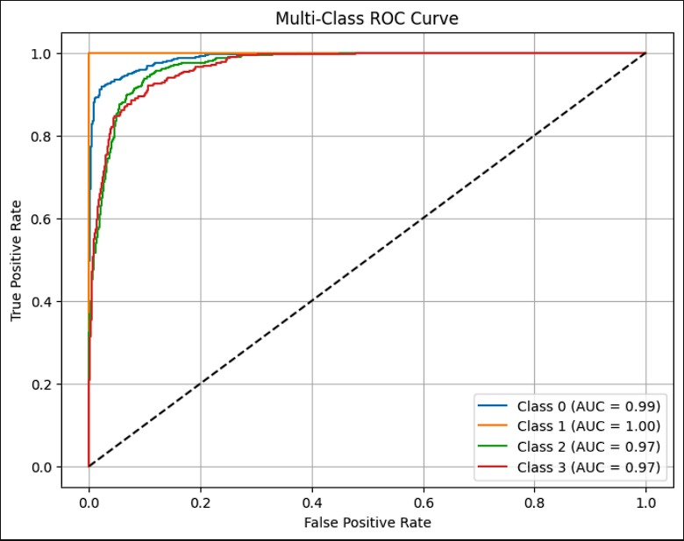
TEAM-3
22BIO211
RESULTS
CNN Model
Hybrid Model

Slide 16
CONCLUSION
TEAM-3
22BIO211
This study demonstrates the effectiveness of deep learning-based MRI classification for detecting Alzheimer’s disease. The CNN model achieved a training accuracy of 96.29% and a validation accuracy of 98.58%, showing high performance in distinguishing different levels of cognitive impairment. However, while CNN performed well on validation data, it showed signs of overfitting.
To improve generalization, a hybrid model (CNN + SVM, XGBoost, Random Forest) was introduced, achieving 96.94% training accuracy and 90.77% test accuracy. The hybrid model provided better generalization on real-world unseen data and improved classification robustness, as reflected in its F1-score of 0.9078 and MCC of 0.8770.
Both models demonstrated strong classification capabilities, but the hybrid model performed better in real-world applications by addressing class imbalances and enhancing generalization. Future enhancements include multi-modal data integration (MRI + genetic markers + PET scans), explainable AI (XAI) for transparency, and cloud-based deployment to improve accessibility for early Alzheimer’s detection.

